Slide 1
Multiple Chronic Conditions: a Descriptive Analysis (with focus on Depression)
Group 2:
Fiza
Daniel
Denisse
Katherine
Shipra
Mimi

Slide 2

What are Chronic Conditions?
Chronic conditions are diseases lasting 1+ yr
Per CDC* data, chronic diseases:
Leading cause of death / disability in the US
*Image Source: CDC | CDC = Centers for Disease Control
Notes:
Daniel

Slide 3

Chronic Diseases Impose an Enormous Economic and Public Health Cost
The US spends $3.5 trillion per year on healthcare, more than the GDPs of France, India and the UK
Of this, ~$1.75 trillion is spent on the sickest 5% of patients, almost all with multiple chronic conditions
*Image Source: The Hill
Notes:
Daniel
The aim of our work is to characterize this population using publicly available CMS and CDC data.

Slide 4
Data sources and description
Chronic Multiple Conditions:
Data source: CMS https://data.cms.gov/medicare-chronic-conditions/multiple-chronic-conditions/data/2017
Background: includes demographic information on patients living with MCCs.
Data Exploration: Demographic information on geographical regions, age groups, .
Data Cleaning: Includes stratifying & observing the data at state/county level to ask questions like high rates of prevalence and admittance rate to hospitals.
Data Preparation: Data visualization at the state level and grouped by age levels suitable for comparability.
*Note: CMS = Centers for Medicare and Medicaid
Notes:
Shipra
Source of data: Centers for Medicare and Medicaid Services (CMS) for understanding multiple chronic conditions, open data API for the year 2017.
Background: Demographic information includes age level, geographical regions like state, county, prevalence rate based on MCC groups - occurrence of one or more conditions, medicare, medicaid care, rate of admittance to hospitals and ER visits.
Cleaning: Cleaning involved stratifying & observing the data at state level to ask various questions seen later in slides. Added missing information like state code in territories/states.
Preparation: State and Age-level demographic information.

Slide 5
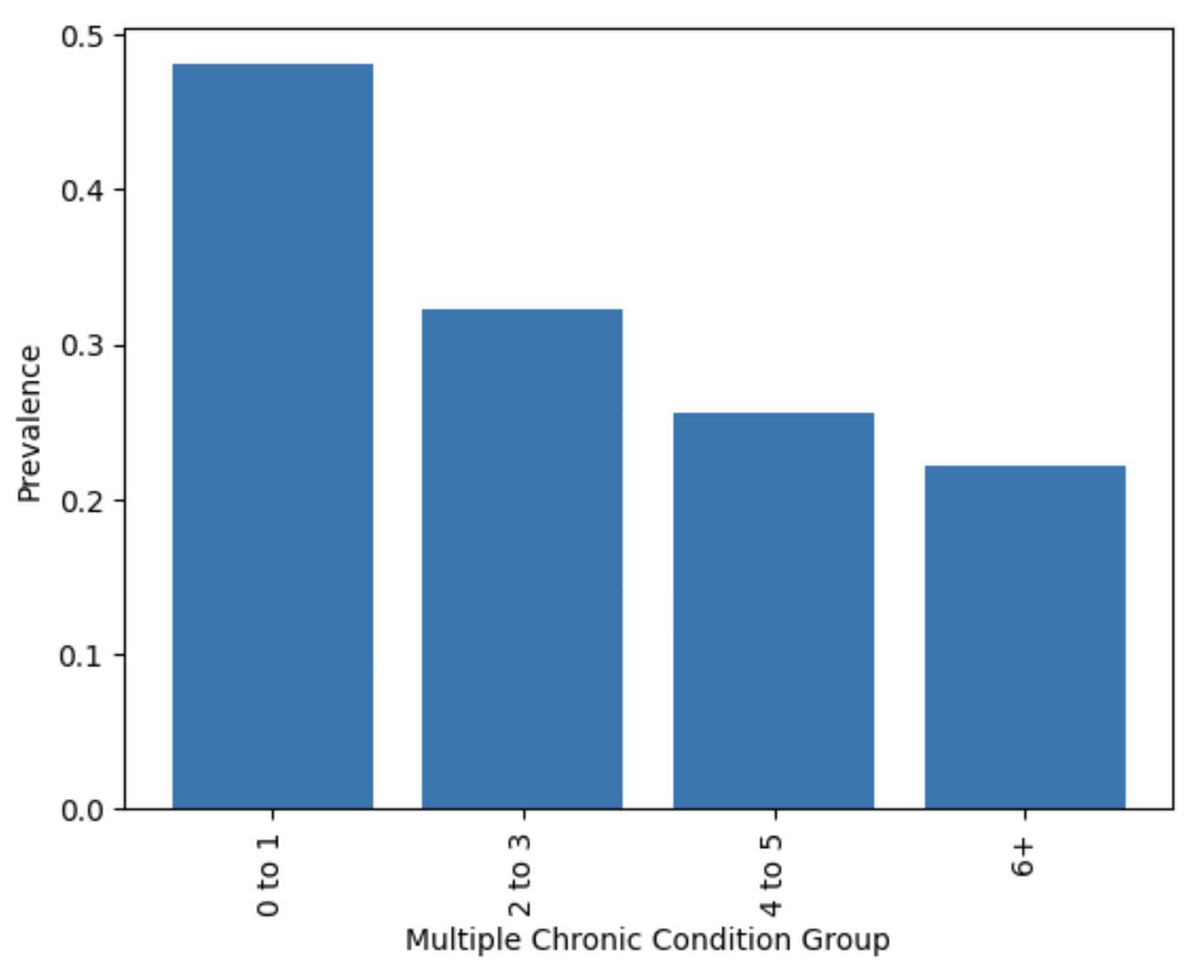
MCCs Grouped by Number of Conditions*
MCC 0 to 1 represent 1 chronic condition and have the highest prevalence.
MCC 2 to 3 represent 2 - 3 chronic conditions
MCC 4 to 5 represent 4 - 5 chronic conditions
MCC 6+ represent 6 and plus chronic conditions
*Note: We grouped MCCs at the state level
Notes:
Fiza

Slide 6
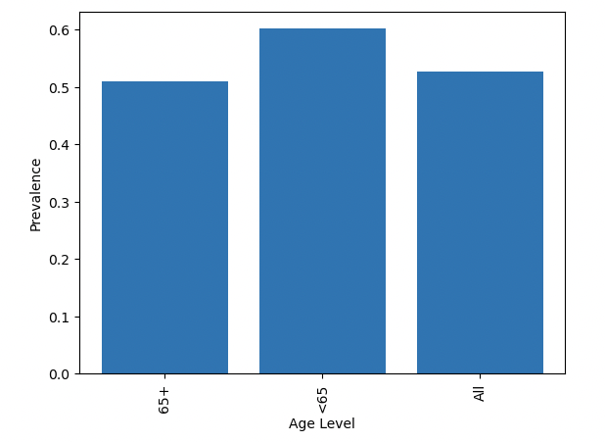
Demographics Associated with MCCs
Prevalence & Age Level:
Interestingly, MCC’s are more prevalent in age groups younger than 65
This finding could have various implications for healthcare and public health interventions. It might indicate the need for early screening and preventive measures to manage chronic conditions among younger populations.
Notes:
Fiza
Through our data, we saw a correlation between age and the prevalence of MCC. This graph shows us the prevalence of MCC’s occurs more in people younger than age 65. This gives us great insight into how much of a need there is for health screenings and preventive measures for all ages.

Slide 7
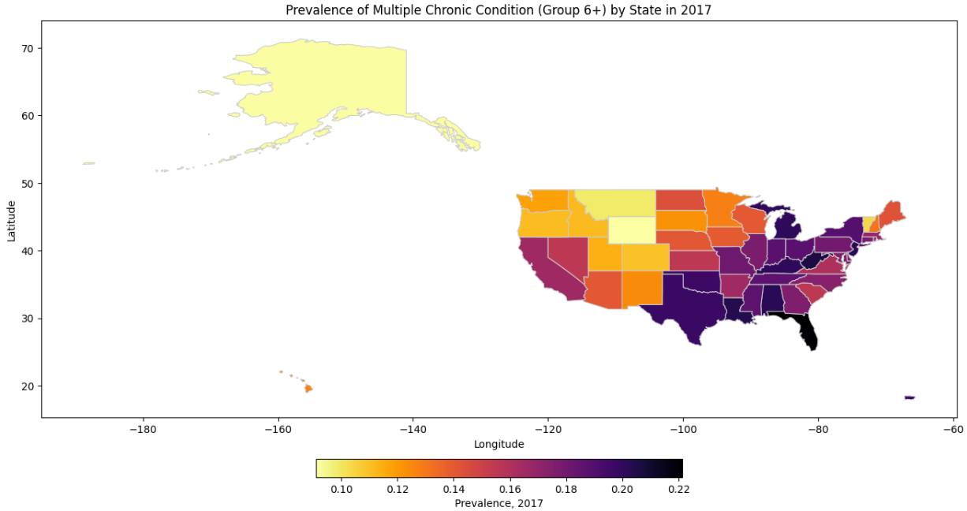
Geographical Distribution of MCC 6+ Group
East coast and South states represent high prevalence rate.
Notes:
Shipra
Through our data, we wanted to observe the most prevalent states with multiple chronic conditions. The data was filtered for chronic condition level 6+ highest number of diseases with prevalence rate. A pattern of neighboring states with high prevalence is observed.

Slide 8
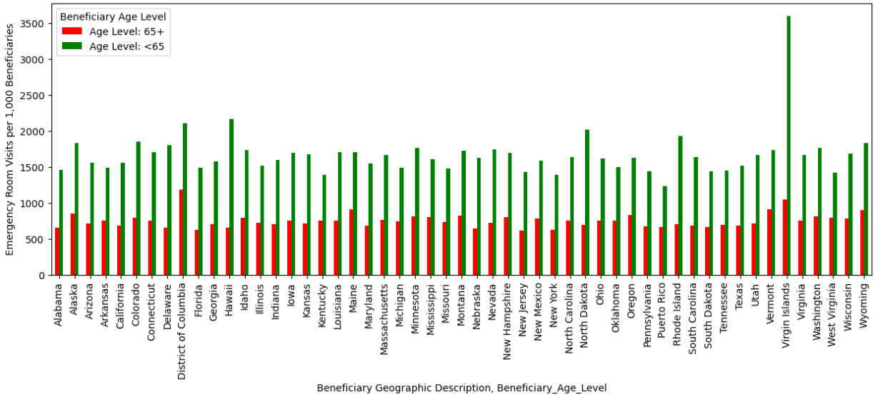
Age & Geographic Association with ER Visits
<65 Age group have high ER visits than 65+ age group. Virgin islands, Hawaii and DC have higher ER visits.
Notes:
Shipra
In this graph, we found that in certain states and US territories, there are more emergency room visits of (less than 65 age groups) in areas with smaller populations like the virgin islands and Hawaii. Less than 65 age groups could have been stratified in several age categories to focus on child, adult and senior citizen groups.

Slide 9
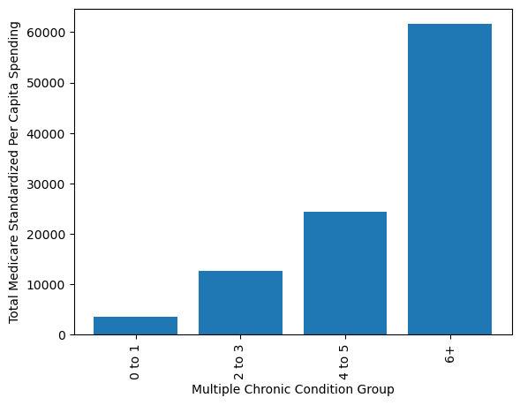
Healthcare Spend as a Function of Disease Burden
On average in the US, as the number of chronic conditions present in an individual increases, the average amount of money spent on medical resources also increases at an alarming rate.
Notes:
Katie
After looking at which demographics and areas are affected by MCCs, we looked at how it impacts the daily lifestyle of individuals in the US with challenges in respect to medicare spendage and trips to the hospital. On average in the US, as the number of chronic conditions present in an individual increases, the amount of money spent on medical resources also increases at an alarming rate.

Slide 10
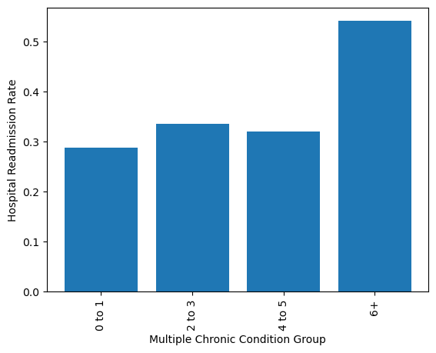
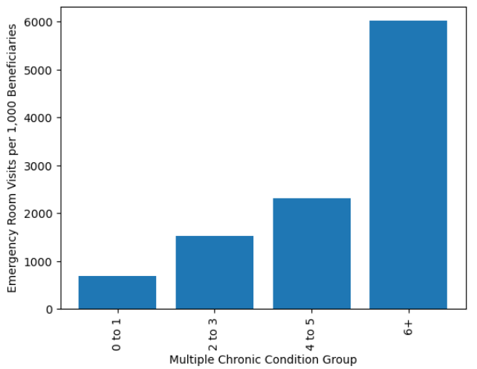
Hospital/ER Utilization as a Function of Disease Burden
Notes:
Katie
Additionally, here we see a similar message where when the number of conditions increases, so does the amount of trips to the hospital. The implication of this data coupled with the notion that MCC is understudied shows why studying MCCs should be a rising concern in the US.

Slide 11
Limitations of the MCC Data
The CMS data provides an incomplete view into the MCC population. Incomplete variables include:
Health insurance status (e.g., Medicare vs. Medicaid vs. Dual vs. Commercial)
Measures of socioeconomic status (e.g., household income)
Healthcare accessibility (e.g., islands away from mainland, county-level supply of doctors, hospital beds)
Data on underlying chronic diseases (e.g., most common ones, most common comorbidities)
Sex and Race variation across the US state.
Less information at the state level, more granular at the county level. Representing the counties in every state with specific questions required multiple steps of filtering of data before one could frame questions to analyze the data.
Notes:
Shipra

Slide 12

Chronic Disease Focus: Depression
Depression is a very prevalent chronic condition, affecting upwards of ~20% of US adult population
There is a bidirectional relationship between depression and chronic illnesses
Unlike diabetes and heart disease, the causes of depression are not as widely understood
Notes:
Daniel

Slide 13
Depression Data Sources and Description
Data source: https://www.cdc.gov/nchs/nhis/nhis_2017_data_release.htm
Correlation with MCC: Depression is a chronic illness, and has a bidirectional relationship with the other physical chronic diseases.
Background/ Data Exploration: Includes demographic, gender, and health information on patients with depression.
Data Cleaning: Includes stratifying & observing the data to find possible factors that could be correlated with depression.
*Note: CDC = Centers for Medicare and Medicaid; NHIS = National Health Interview Survey
Notes:
Denisse the data was collected from cdc database which is descriptive data. Our focus was to primarily collect the data by gender, demographics and the potential correlation with chronic conditions and depression.

Slide 14
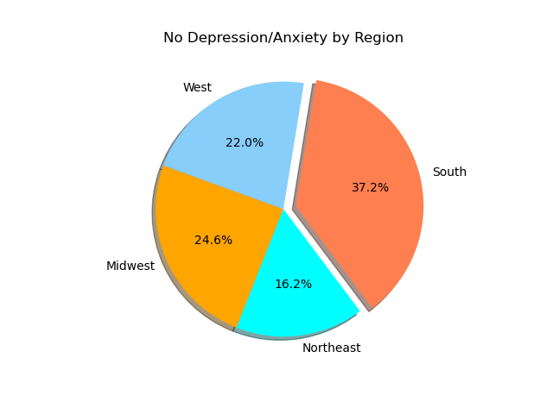
No Depression / Anxiety by Region
The South has the highest number of people without depression while the lowest percentage was found in the Northeast
Notes:
Denisse The highest percentage without Depression and Anxiety was found in the South region while the lowest percentage was found in the Northeast. But this might be due to the fact the majority of people surveyed was in Northeast.

Slide 15
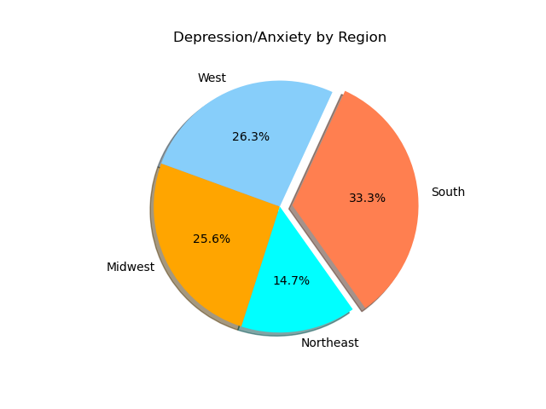
Depression / anxiety by region
The highest percentage of people with depression was also found in the South, followed by the West
Notes:
Denisse Also the highest percentage of people suffering from depression and anxiety was found in the southwest
Surprisingly we found the the highest percentage of depression was found in South followed by Midwest
As an observation the perdentages in
We found surprising how close the percentages are between depressed and not depressed people in all regions.
Later we discovered that our data had two other variables; such as 1- people who refuse to answer and 2- people who was not ascertained
If you compare this slide and the previous one, you’ll notice that the percentages in each region don’t add up to 100%, t
Also, the percentages in each region don’t add up to 100%, this is probably due to respondents choosing not to answer questions about disease status. Other respondents said they ‘did not know’ whether they had depression.

Slide 16
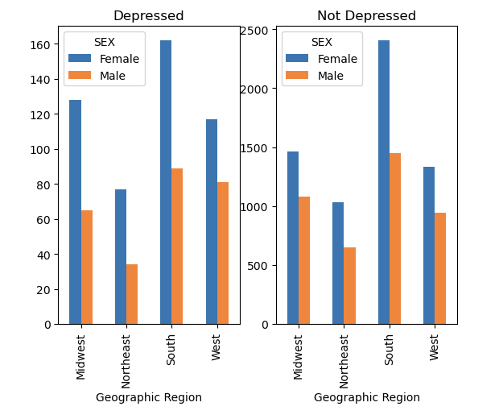
Depression Prevalence by Sex, Geography
The number of depressed
females is higher than the
number of non-depressed
females in the Midwest and
West regions.
Notes:
Denisse Here our data is shown by gender in this graph we can see that females are more prone to suffer from depression and anxiety than males in all regions.

Slide 17
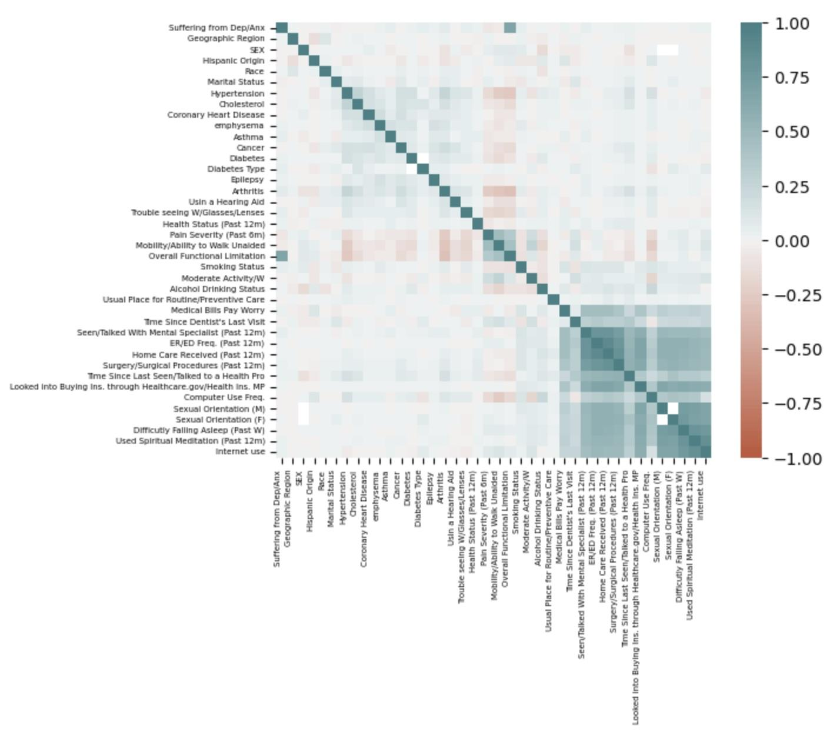
Correlation Matrix Showing Strength of Association between Different Factors
Overall Functional Limitation
Hypertension
Arthritis
Pain Severity
Health Status
Smoking Status
Notes:
Daniel
This is a correlation matrix showing the degree of association between different variables. Dark green = significant positive correlation; Dark red = significant inverse correlation
We used this matrix to identify these factors as having the strongest association with depression.

Slide 18
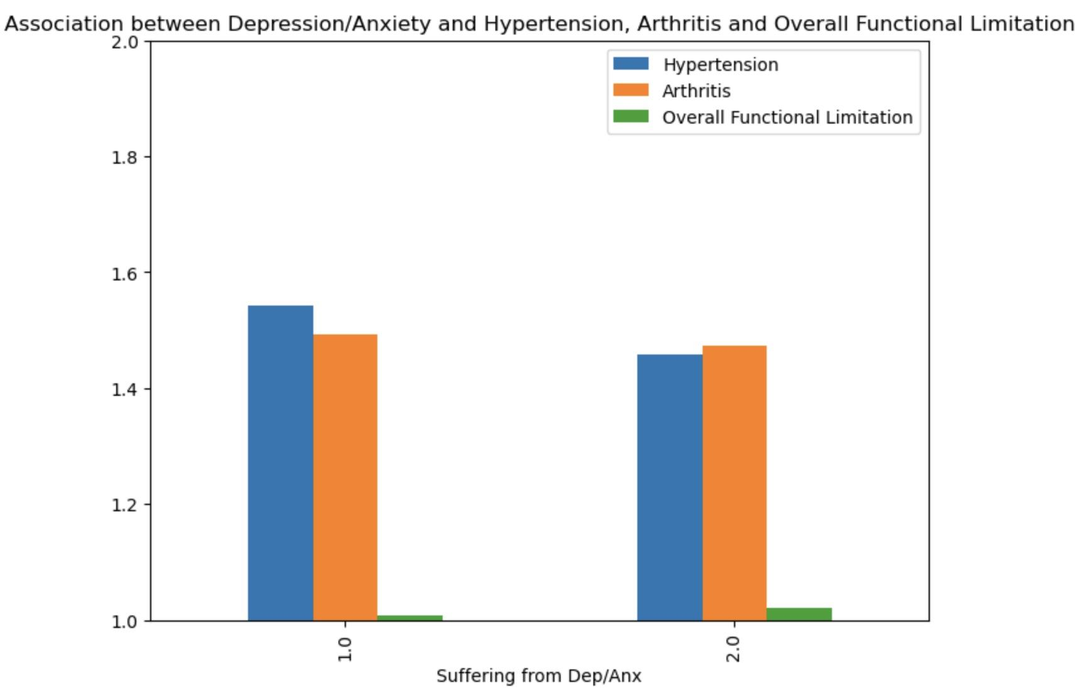
Chronic Diseases Having Significant Association with Depression
Individuals with depression are more likely to have hypertension, or, arthritis than those without.
*Note: 1.0 = has depression; 2.0 = no depression
Notes:
Daniel

Slide 19
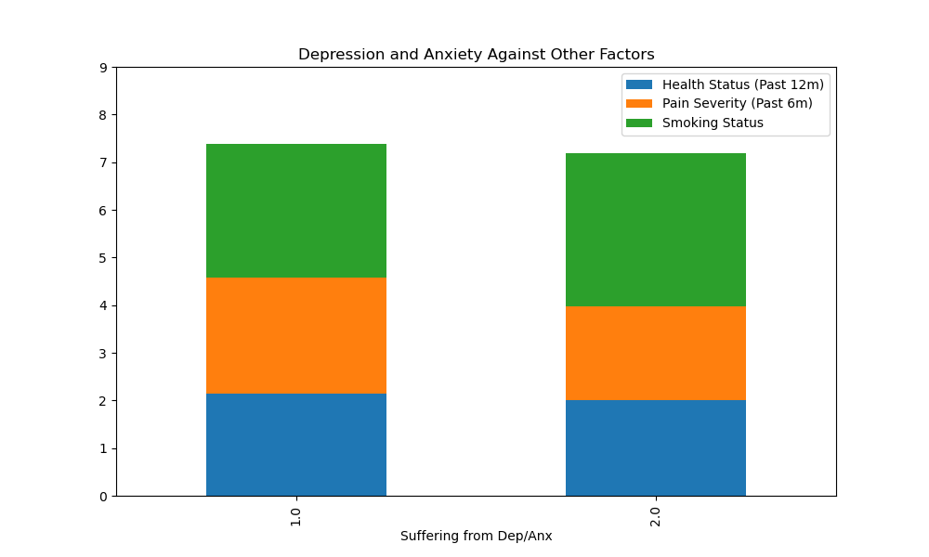
Health Status, Pain Severity, & Smoking Status in Correlation with Depression
One point worth noting here is,
the percentage of smokers
among individuals who do not
have depression is slightly
higher than the percentage of
smokers among those who
have depression. Also,
individuals with depression are more
likely to have pain than those
without.
*Note: 1.0 = has depression; 2.0 = no depression
Notes:
Mimi
According to this dataset as you can see here, the percentage of smokers among those who do not have depression is slightly bigger than the percentage of smokers among those who do have depression. Also, if you look at the orange area on the graph, it shows that the percentage of pain severity is slightly bigger among those who have depression.

Slide 20
Limitations of the Data (CDC Dataset)
The 2017 NHIS* dataset provides a limited view into the population suffering from depression. Missing variables include:
Depression status (only asked to those with self-reported functional limitation)
Geographic data at the state, county, metro, or zip code levels
Health insurance status (e.g., Medicare vs. Medicaid vs. Dual vs. Commercial)
Measures of socioeconomic status (e.g., household income)
Health metrics (e.g., BMI, self-reported health status, self-reported life satisfaction)
Female respondents outnumbered males by 20%
No age stratification (i.e.,, <1 yr, 1-84 yrs, 85+ yrs)
Uncertain whether survey equally distributed by region
Notes:
Mimi
Our dataset provides a limited view into the population suffering from depression, there’s a lot of missing variables like depression status,( we are not certain if depression is correlated with functional limitation for example), and Health insurance status. Female respondents outnumbered males by 20%, there’s no age stratification, and we’re not certain whether the survey was equally distributed by region.

Slide 21

Future steps
Find and analyze association of geographic factors on MCCs. Ex:
Supply of MDs, RNs in a region
Poverty rate with a zip code
Income per family
Environmental aspects
Analyzing ‘clustering’ of chronic conditions. Ex:
Diseases occurring concomitantly
Demographic, geo, socioeconomic factors associated with clustering
Notes:
Mimi
We’ll have to find and analyze association of geographic factors like supply of MDs and RNs in a region for example, also poverty rate….
We also have to analyze clustering of chronic conditions, like diseases occurring simultaneously, or the demographic, geo, socioeconomic factors that are associated with clustering as well, and that concludes it.

